Slide 1
Windows Azure
Scott Guthrie
Corporate Vice President
Windows Azure
Email: scottgu@microsoft.com
Twitter: @scottgu

Slide 2

Windows Azure
Move Faster
Save Money
Hybrid Consistency
$

Slide 3
Global Footprint

Slide 4
pay only for what you use
→

Slide 5
no upfront costs

Slide 6

per minute billing

Slide 7
no charge for stopped VMs
$

Slide 8
Windows Azure

Slide 9

Virtual Machines
Windows Server and Linux Virtual Machines
Flexible Workload Support
Virtual Private Networking

Slide 10



Load Balancing and High Availability
Availability Set
Load-Balanced Traffic (TCP/UDP)

Slide 11
Availability Sets + LBs

Slide 12
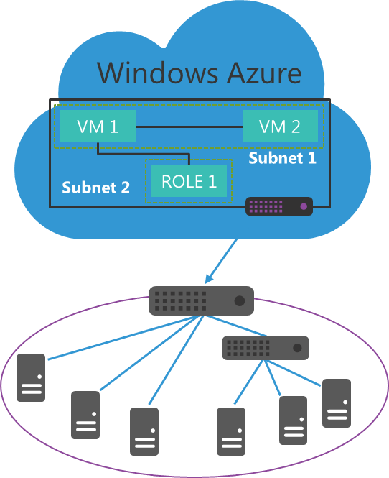
Windows Azure Virtual Networks
Build virtual networks that scale
Traditional, familiar approach to build extension to datacenter
Scalable approach to building virtual networks
Control over network configuration
Define your own IP address ranges
Be compliant with corporate IT security policy
Enables rich hybrid scenarios
Hybrid apps can reach all or portion of the on-premise network
Works with both Windows and non-Windows systems
Corpnet

Slide 13





Virtual Gateways
Contoso Production VNet in Windows Azure (10.1.0.0/16)
Point-to-Site
VPNs
Contoso HQ (10.0.0.0/16)
10.1.2.0/24
10.1.3.0/24
SQL Farm
IIS Servers
131.57.23.120
S2S VPN tunnel
65.52.249.22
10.1.0.4
10.1.1.4
10.0.0.10
10.0.0.11
Contoso Test in Windows Azure (10.2.0.0/16)
AD / DNS
S2S VPN Device
S2S VPN tunnel
Exchange
BRK Gateway
10.2.2.0/24
10.2.3.0/24
Point-to-Site
VPNs

Slide 14
Command Line
Automation

Slide 15
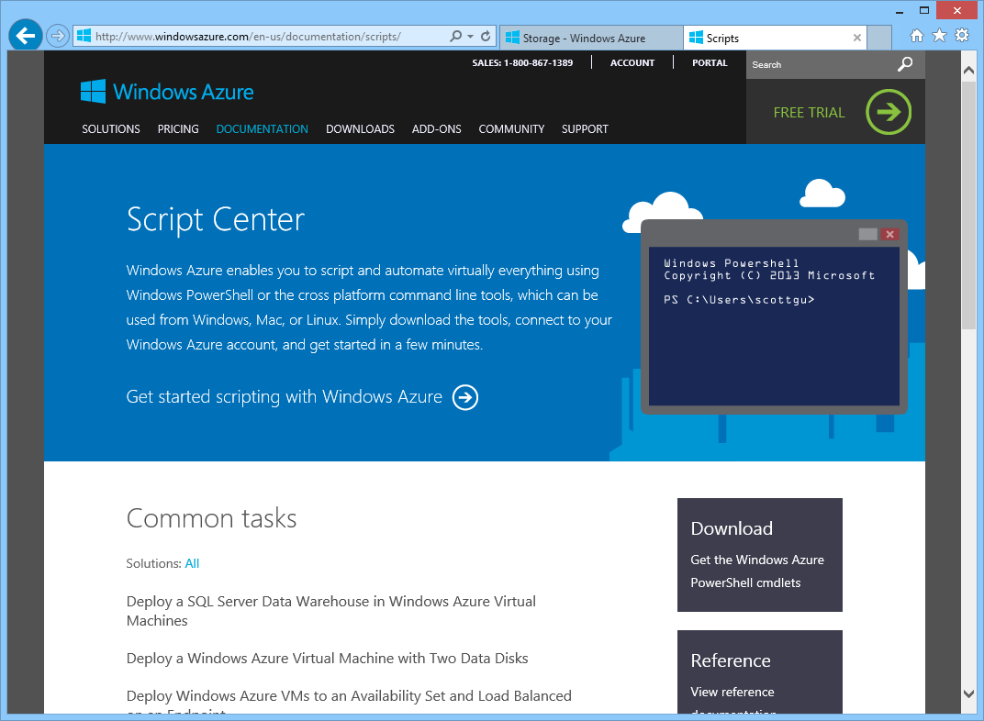

Slide 16
Dev/Test Scenarios

Slide 17
MSDN Member Benefits
No credit card needed for MSDN members to sign up
Discounted rates for Dev/test scenarios (up to 97% savings)
MSDN credits per month-use for any Dev/test scenario

Slide 18




MSDN Credits with Windows Azure
$50
per month
for Visual Studio Professional
$100
3 VMs for 16 hours a day
per month
for Visual Studio Premium
$150
per month
Up to 500 web sites plus SQL DB
for Visual Studio Ultimate

Slide 19
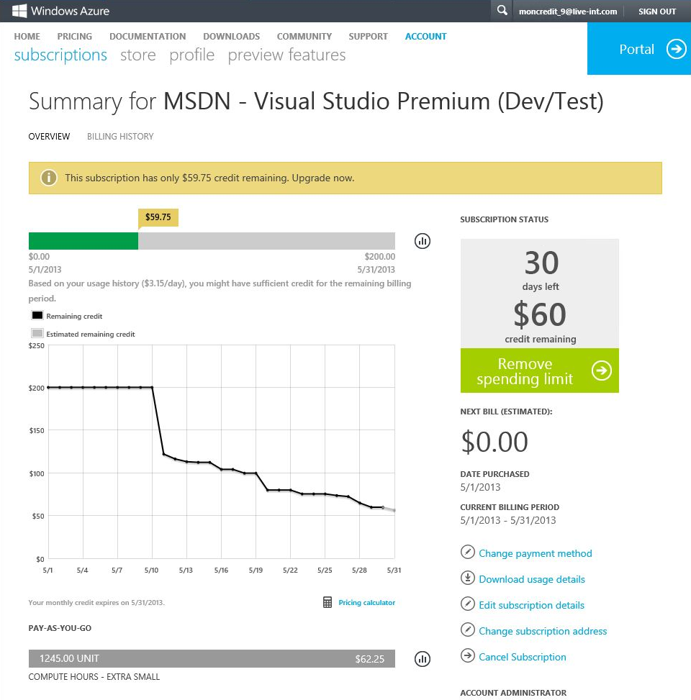

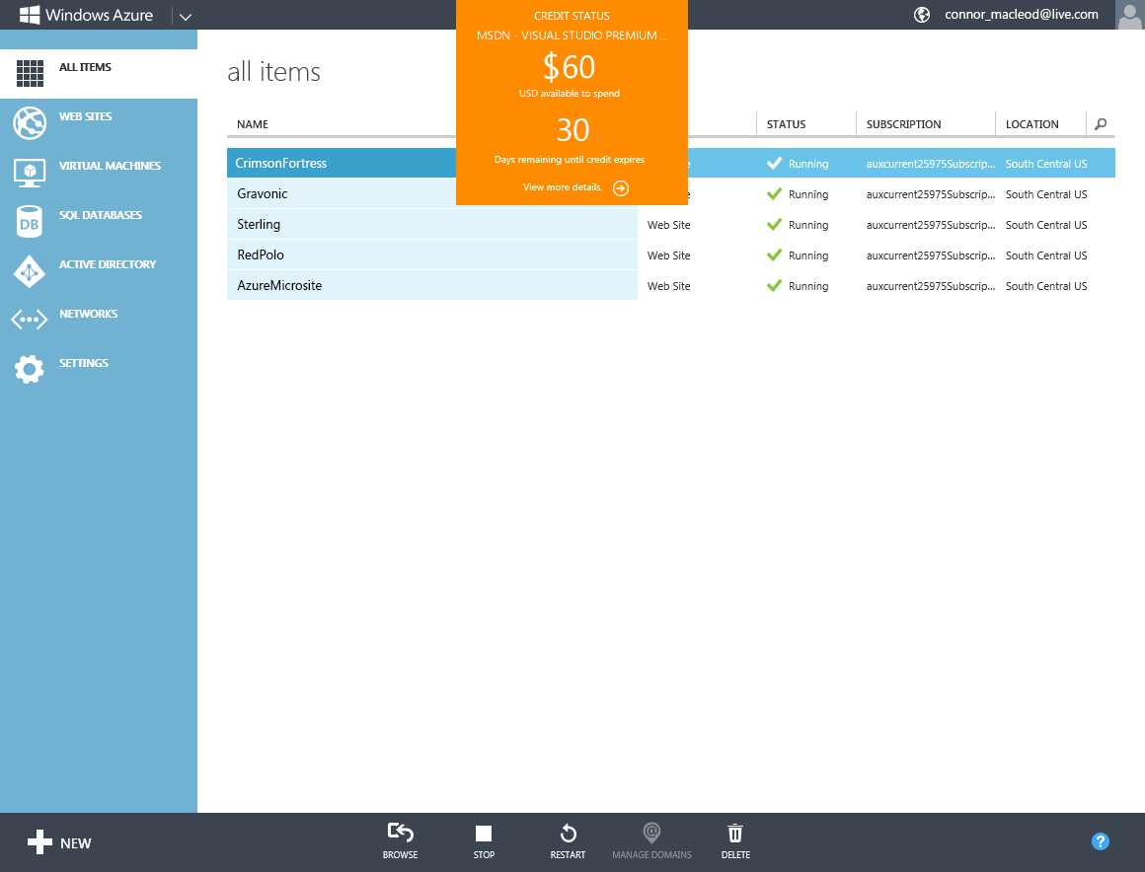
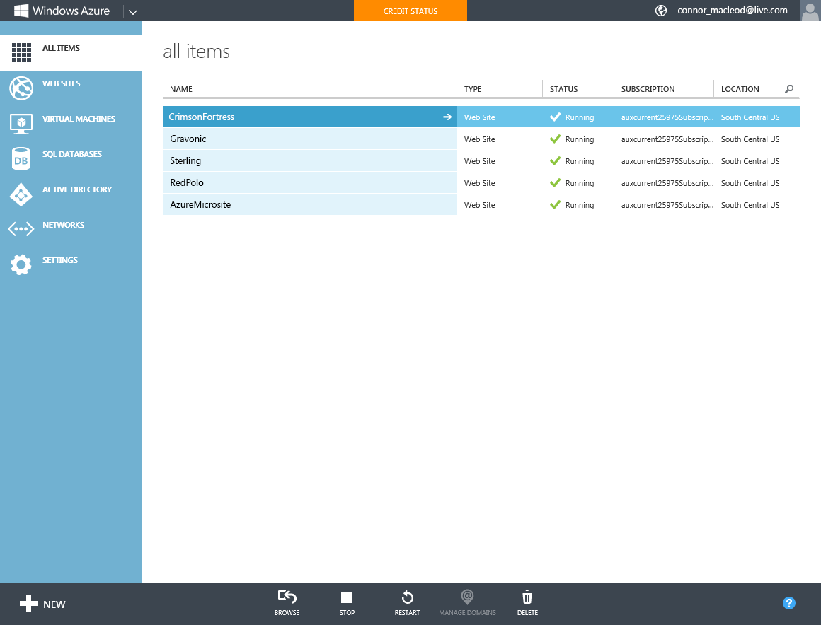

Slide 20
focus on apps, not infrastructure

Slide 21













application building blocks
HDInsight
SQL DB
Storage
Traffic Mgr
Cloud services
Cache
CDN
Active Directory
Web Sites
Mobile
media
Service Bus
BizTalk

Slide 22

SQL Database
Relational SQL Server Engine in the Cloud
Clustered for high availability
Fully Managed Service

Slide 23
SQL Database

Slide 24

Web Sites
Build with ASP.NET, Node.js or PHP
Deploy in seconds with FTP, Git or TFS
Easily scale up as demand grows

Slide 25
Web Sites

Slide 26
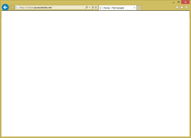
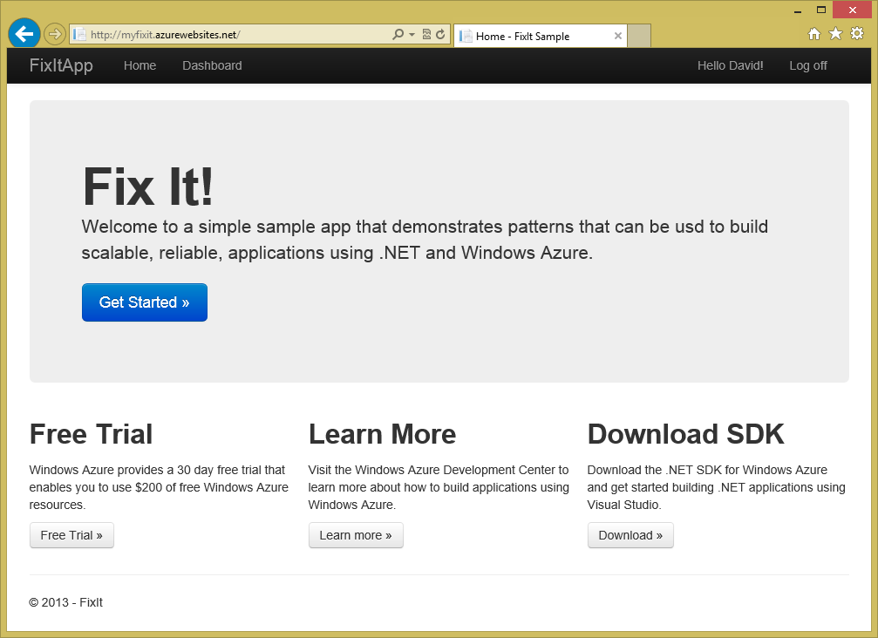
Windows Azure Web Site Service
Reserved Instance
Virtual Machine with
IIS already setup
(1 of 2)
Load Balancer
(1 of n)
Reserved Instance
Virtual Machine with
IIS already setup
(1 of n…)
Server Failure….
Reserved Instance
Virtual Machine with
IIS already setup
(2 of 2)
Load Balancer
(2 of n)
Reserved Instance
Virtual Machine with
IIS already setup
(2 of n…)
Dev tool or
Automation Script
Deployment Service
(FTP, WebDeploy, GIT, TFS, etc)
Reserved Instance
Virtual Machine with
IIS already setup
(2 of 2)

Slide 27
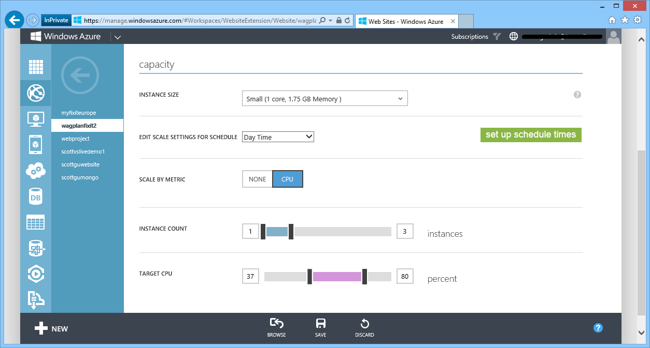
AutoScale – Built-into Windows Azure
AutoScale based on real usage
CPU % thresholds
Queue Depth
Supports schedule times

Slide 28
AutoScale

Slide 29
Dev/Ops Workflow
Develop
Repeatable
Reliable
Predictable
Low Cycle Time
Learn
Deploy
Operate

Slide 30
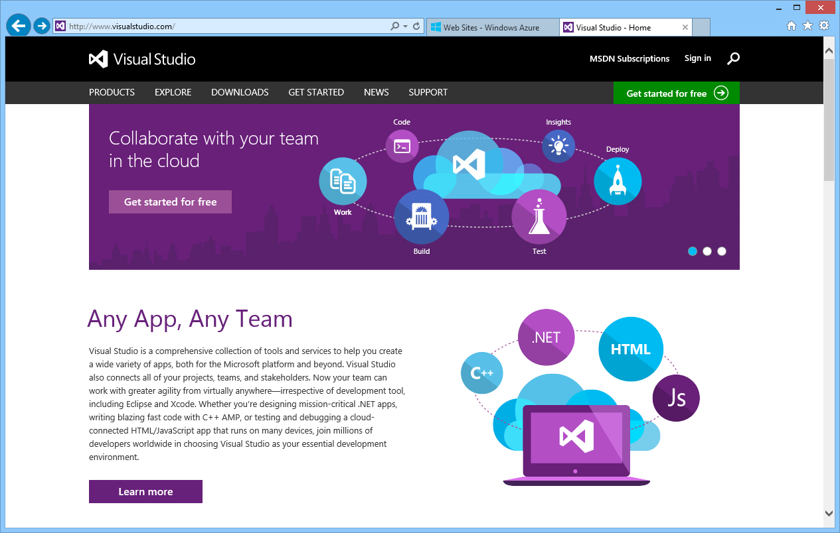
Visual Studio Online
TFS and Git support
Elastic Build Service
Continuous Integration
Continuous Delivery
Load Testing Support
Team Room Collaboration
Agile Project Management

Slide 31
Continuous Deployment

Slide 32

Running a Live Site Service

Slide 33
Running without Insight / Telemetry

Slide 34
Logging and Telemetry

Slide 35

Storage
Highly scalable, durable, available storage system
Blobs can be exposed over http (JSON + CORS)
Optionally enable client apps short term access
Import / Export Service with Physical Drives

Slide 36

Active Directory
Active Directory in the Cloud
Integrate with on-premises Active Directory
Enable single sign-on within your apps
Supports SAML, WS-Fed, and OAuth 2.0

Slide 37

3rd party apps
Windows Azure
Your app in Azure
Windows Azure Active Directory
Windows Server Active Directory

Slide 38
Windows Azure Active Directory

Slide 39
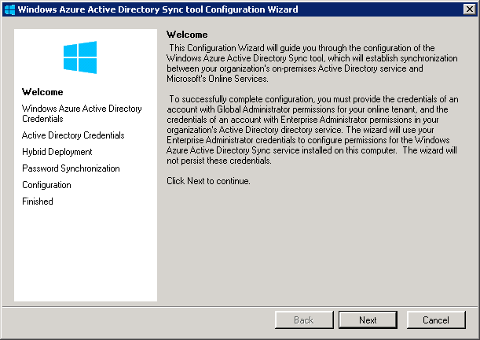
Config wizard automatically launches

Slide 40
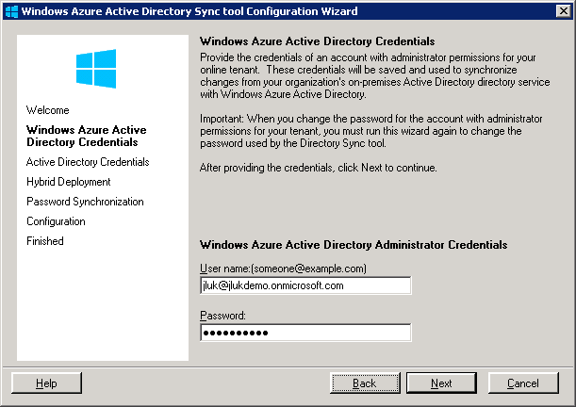
Enter Windows Azure AD Credentials

Slide 41
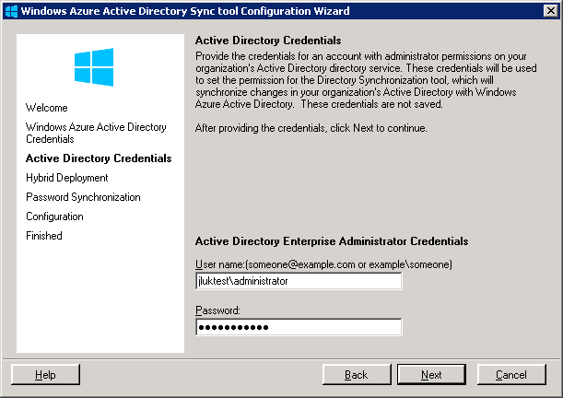
Enter Windows Server AD Credentials

Slide 42
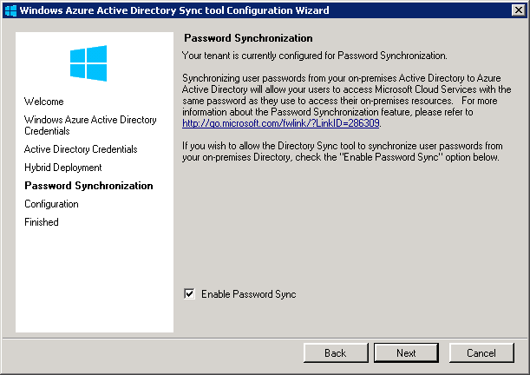
Enable Hashed Password Sync

Slide 43
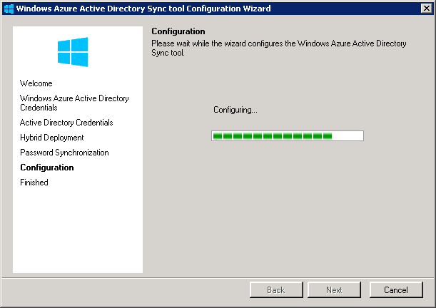
Almost done

Slide 44
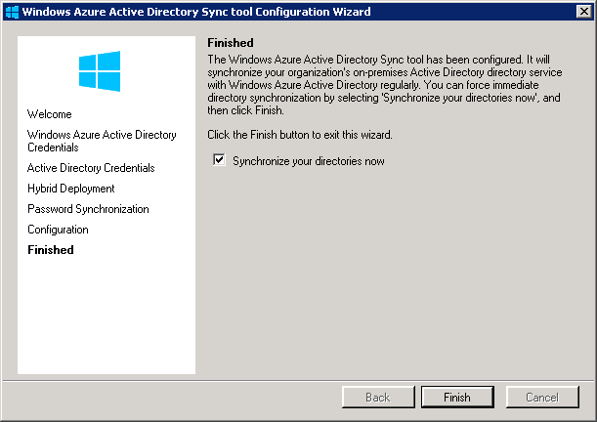
Finished – Sync will start automatically
No need to install on multiple DC’s. No reboot required!

Slide 45
Windows Azure Active Directory

Slide 46
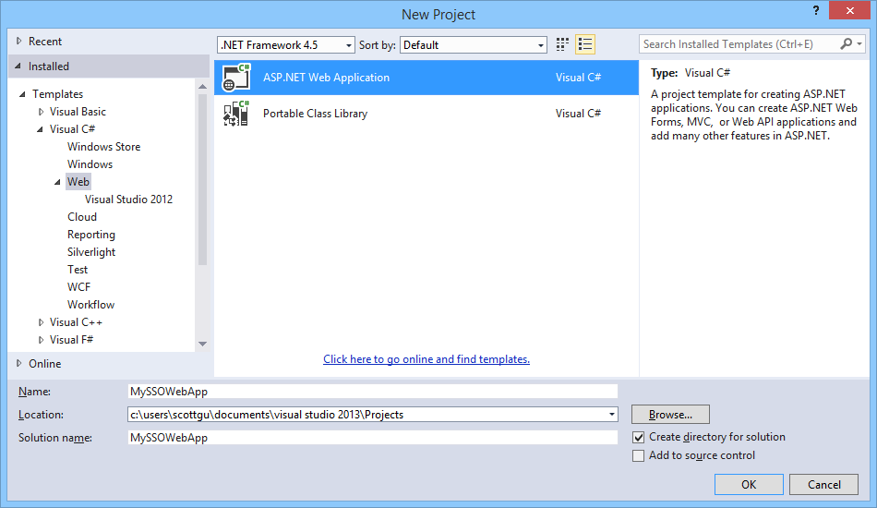
Enable SSO with Azure AD and ASP.NET

Slide 47
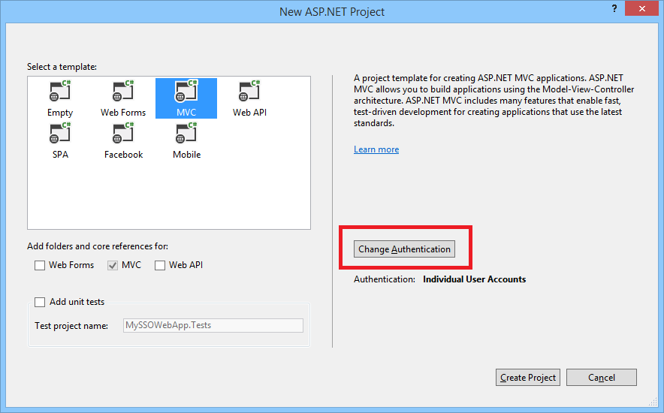
Enable SSO with Azure AD and ASP.NET

Slide 48
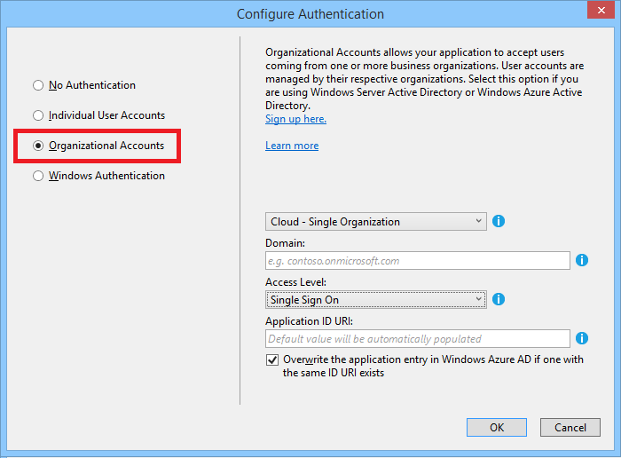
Enable SSO with Azure AD and ASP.NET

Slide 49
application building blocks
HDInsight
SQL DB
Storage
Traffic Mgr
Cloud services
Cache
CDN
Active Directory
Web Sites
Mobile
media
Service Bus
BizTalk

Slide 50
Windows Azure
Move Faster
Save Money
Hybrid Consistency
$

Slide 51

http://friday.azure.com

Slide 52

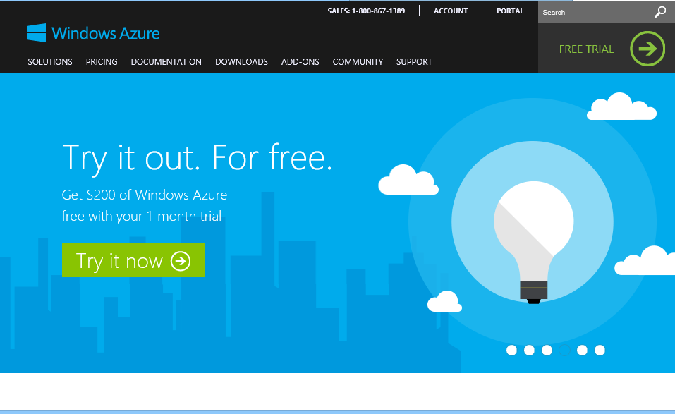
start now.
http://WindowsAzure.com

